Slide 1
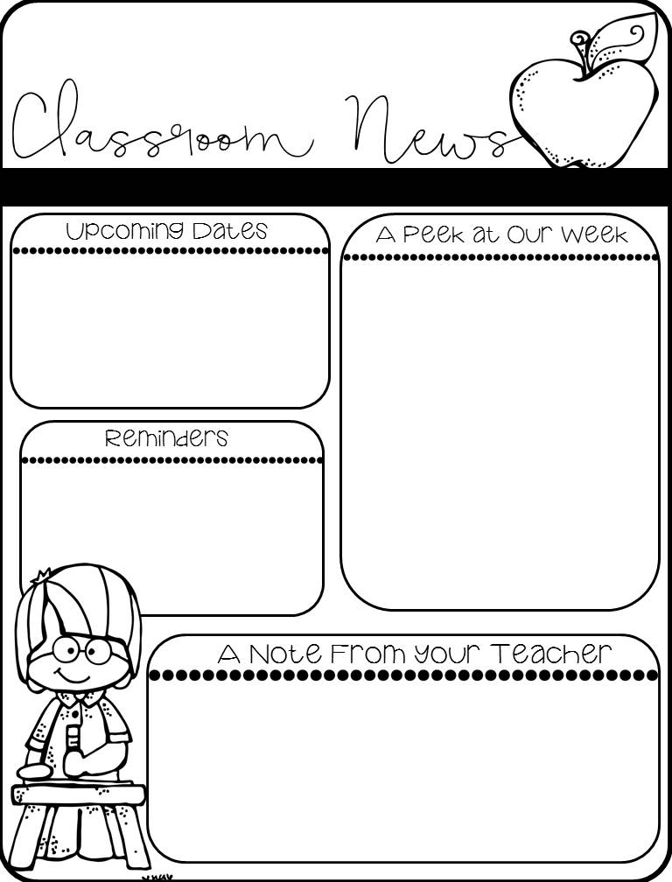
Kindergarten
Week 17:
12/2-12/6
12/2-12/9: MOY MAPS Testing Begins
12/9-12/13: Book Fair
12/16-12/10: PTA Holiday Shop
12/18: Grinch Day
12/19: Kindergarten Christmas Program @9:30am in Cafeteria/Cookie Decorating
12/19: Christmas Feast
12/20: Polar Express Day/Christmas Party
Math: Module 3 Topic C: Comparison of Weight
Reading: Theme: Reindeer
Strategy: Questioning
Writing: Authors! Yes!
Phonics: CVC Words; Uppercase Letters F-J; Syllables
Social Studies: Holidays Around the World
We are visiting the school library and checking out books. Please make sure books come back each day.
School starts at 9:00am. Breakfast is served at 8:30am. Students cannot be dropped off before 8:30am.
Please send in an excuse when your student is absent.
We hope that you had a great Thanksgiving break! We are looking forward to a fun-filled 3 weeks of learning! We begin our MAPS testing this week! Please make sure that students are well rested and are present each day for testing. Please see your teacher for the schedule. We are also in the middle of our Attendance challenge! Let’s keep up the great work in attending each day! Make it a great week on purpose!
~Ms. Summerour, Mrs. Thomas, Mrs. Tovar, and Dr. A

